Slide 1
MemLoc
03/06/2022
Abirami Patchaiyappan
Alexandra Luther
Mythili Karra
Surya Rani
Case Delst
03/06/2022

Slide 2
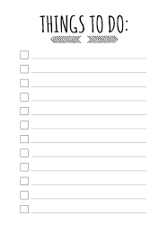

Introduction
MemLoc is a location-based todo list app. It reminds you based on location, time, and date.
Motivation:
Mutual desire on wanting to use the app ourselves
Exciting use of real-world data and API’s
New technology to play with
Background:
We wanted an app that reminded us exactly
when and where we needed it
Notes:
Case

Slide 3


Goals
To build a functional location-based TODO list.
Learn a new tech stack
Learn and practice SCRUM
To learn and master new languages and technologies
Work well together with good communication
Notes:
Alex

Slide 4


Biggest challenges/accomplishments
Challenges:
Creating an intuitive and appealing UI from scratch
Integrating real time location data with frontend state
Integrating all of the API’s smoothly into the application
Learning the new languages and technologies
Accomplishments:
Learned a lot of SCRUM, Agile, and general software development
Implemented all of the tools and technologies necessary
Built it!
Notes:
Alex

Slide 5
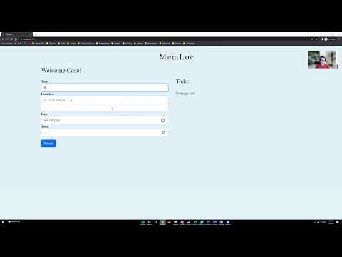
Demo
Youtube Link

Slide 6
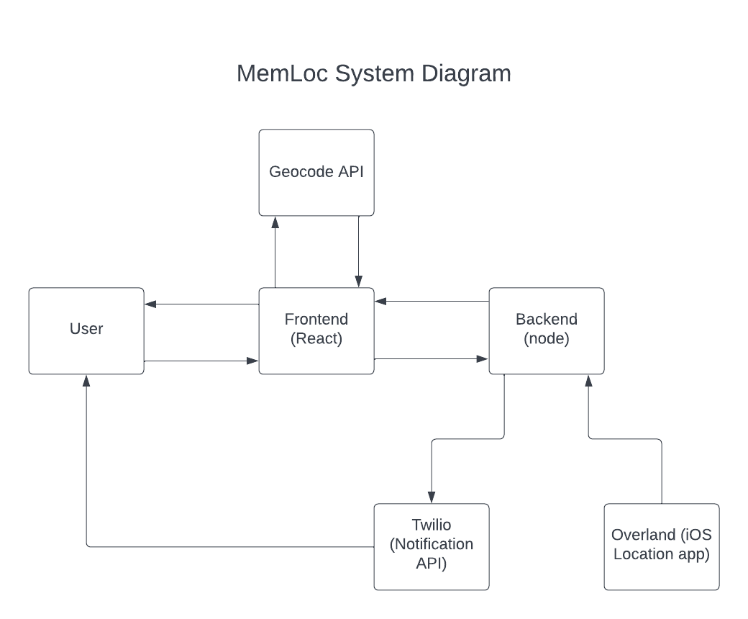
System Overview
Notes:
Case

Slide 7
Technologies used
Javascript
React (frontend)
Node (backend)
Overland (3rd party iOS coordinate app)
Twilio (notification SaaS)
Geocode(location lookup API)
Notes:
Mythili

Slide 8

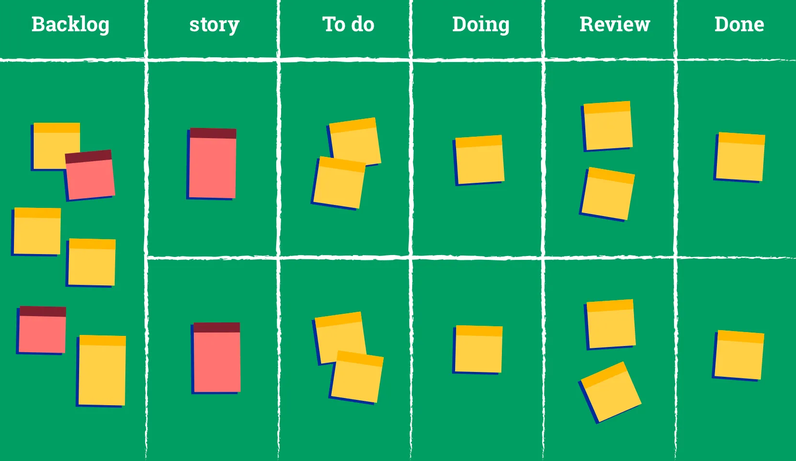
Project Management Techniques
Task breakdown
User stories + tasks
Points + time estimates
Priority
Regular Scrum meetings
Scrum board
Layer by layer approach
Review
Notes:
Abi

Slide 9


Liked/Didn’t like
Enjoyed:
Learning new technologies
Working with team members
Didn’t Enjoy:
Road blocks
Notes:
Mythili

Slide 10



Lessons Learned
What worked?
Regular communication
Documentation
Setting reasonable goals + Prioritizing
What didn’t work?
Saving tests until the end
What we wished we had done
backlog tasks (DB)
Notes:
Abi

Slide 11


Questions?

